Slide 1
BOSCH RESEARCH
Perspective Images → 360° Panorama
1+92 Dataset · v15 Data Contract · 2026-07-15
Dual-version scene-band (A/B) + strict masks — white = strictly real, black = to generate · PRODUCTION COMPLETE: 555 samples delivered
QI PAN
I

Slide 2
DATASET
Dataset: Argoverse 2 Sensor — how much data
1000
555
~300
SENSOR LOGS TOTAL
SAMPLES DELIVERED (A/B)
FRAMES PER LOG
▸ AV2 Sensor: 1000 logs — but test 150 has no 3D annotations, so USABLE = 850 (train 700 + val 150), ~20 s / ~300 frames each.
▸ 7 ring cameras give full 360° coverage + LiDAR + 3D annotations; compute: 3 machines / 108 CPU cores, ~10–12 min per sample (A/B incl.), crash-safe resumable ledger.
▸ DONE — all 850 usable logs judged: val 101 (67%) + train 454 (65%) = 555 dual-version samples; residual median 6.3%, zero unrecovered failures.
II

Slide 3
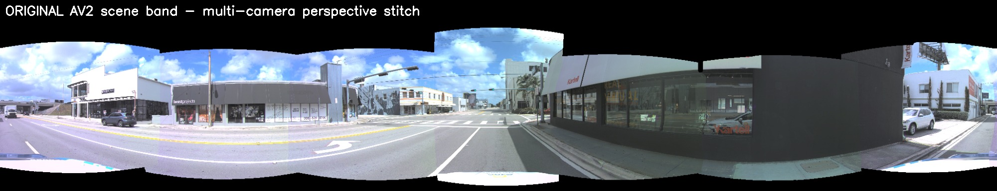
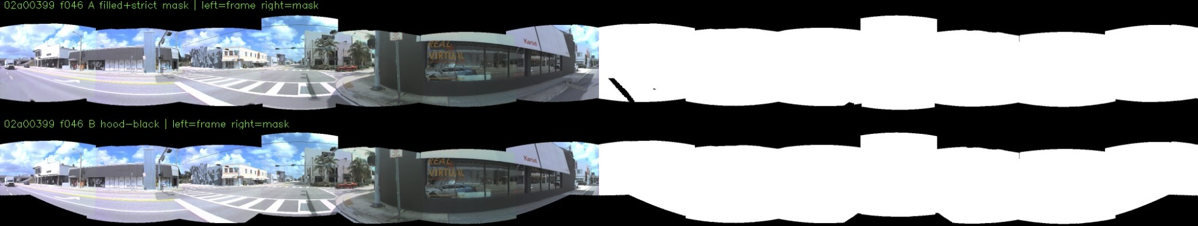
SCENE-BAND
Scene-band: two treatments, one shared mask contract
① Version A — white hood removed, refilled with real road pixels (temporal reprojection + world-BEV). What no camera ever saw — e.g. the lower half of a close-parked truck the hood used to cover — stays honest black.
② Version B —hood region simply blacked out — zero fill. Same windows, same frames as A, masks aligned pixel-for-pixel: a clean A/B pair for training comparison.
③ Mask contract — white = strictly real camera pixels; black = model generates (never-seen occlusions, Telea residue, flawed-seam strips, hood region in B). Both versions ship for every sample.
IV

Slide 4
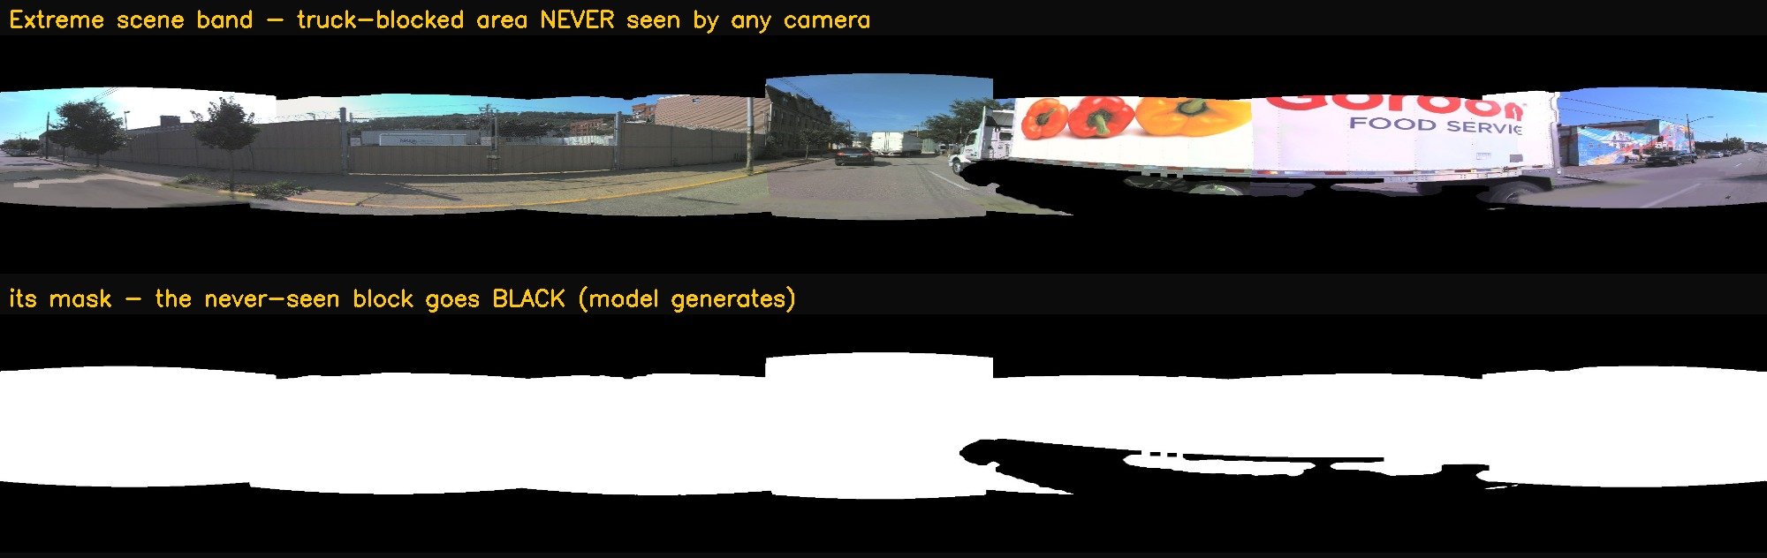

Slide 5
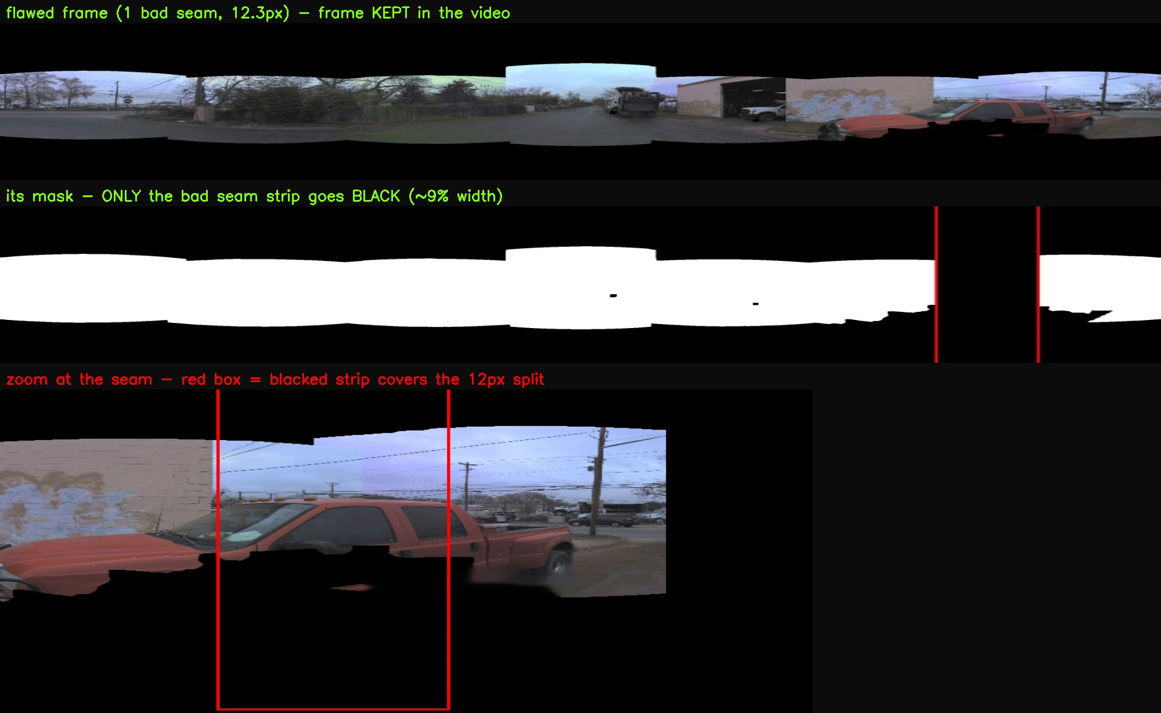

Slide 6
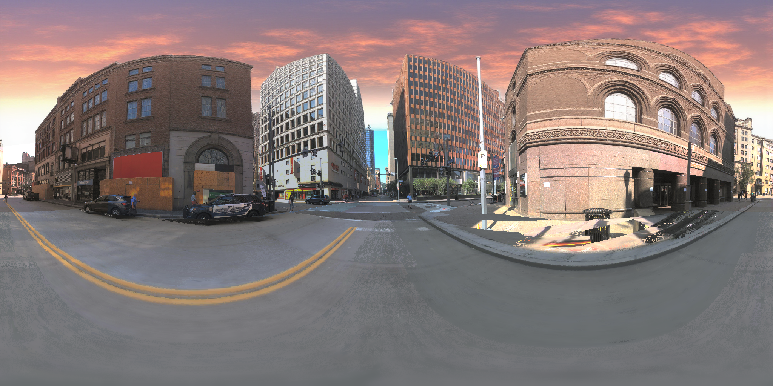
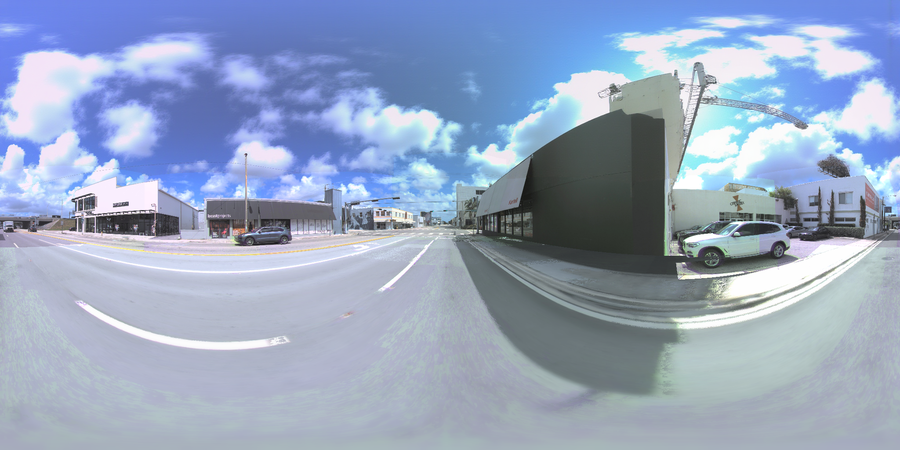
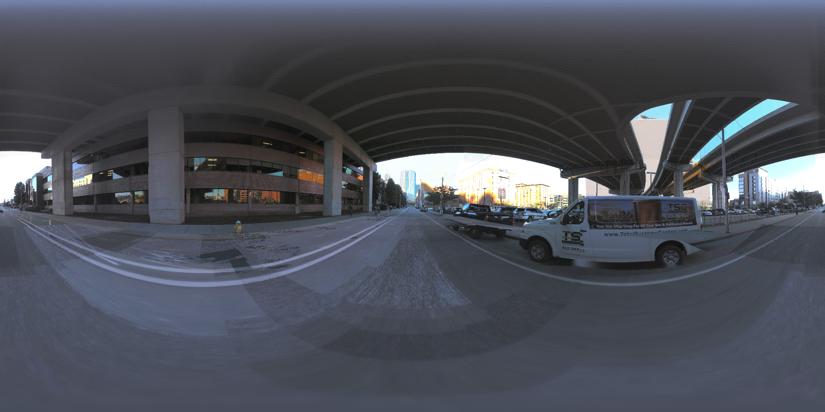
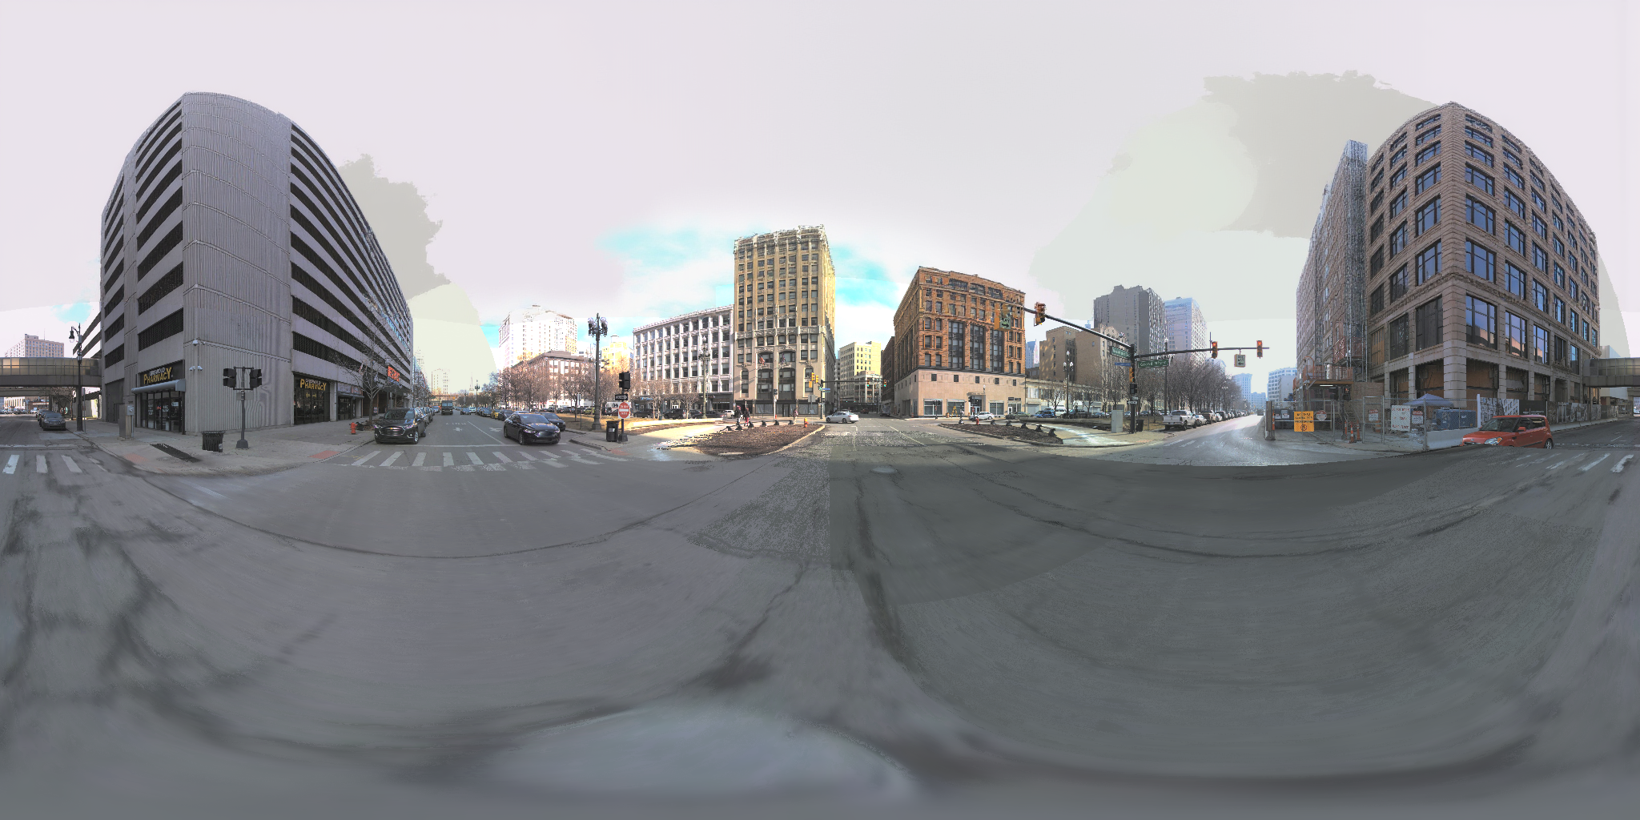
PROGRESS
Progress: COMPLETE — 555 samples (val 101 + train 454) · all 850 logs judged
VI

